Slide 1
Motion Tracking System v2.0: iSee
ELEN 4320: Digital Control Systems
David Helminiak
April 2018
https://pixabay.com/en/machine-mechanical-eye-blue-look-1776925/

Slide 2
Objective
Design a system based on the Arduino Uno for motion detection…
https://www.sparkfun.com/products/11224
https://www.xkcd.com

Slide 3
That sounds very familiar!

Slide 4
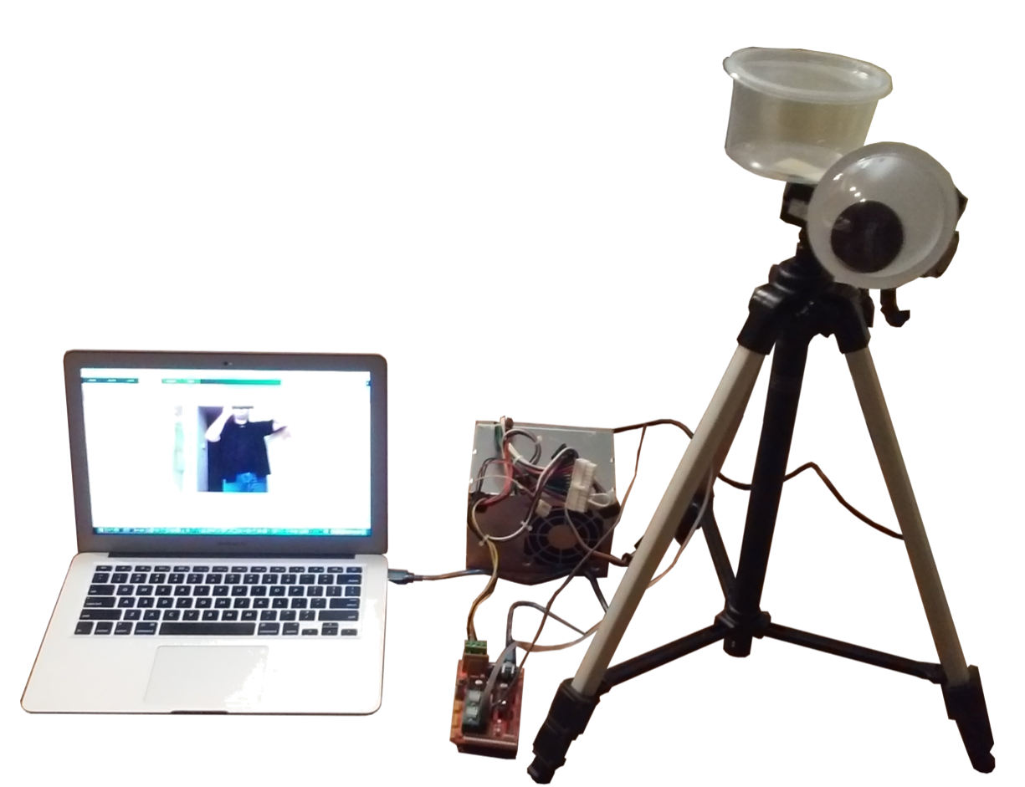
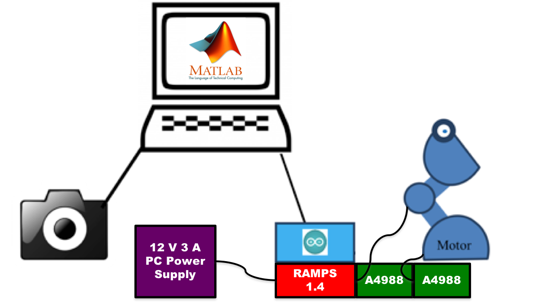
EECE 3015 v1.0: iWatch
Actual System
Design Concept

Slide 5
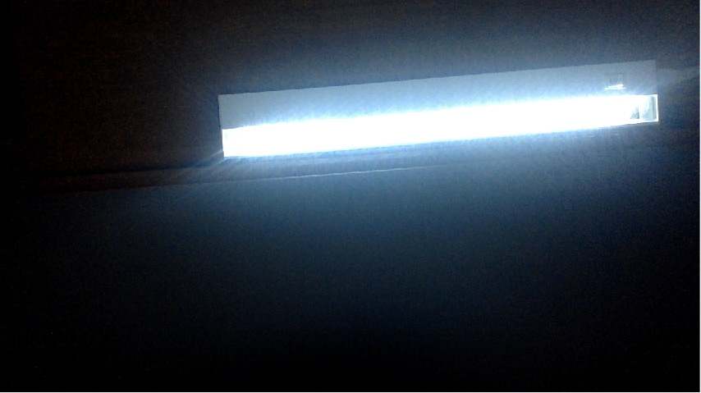
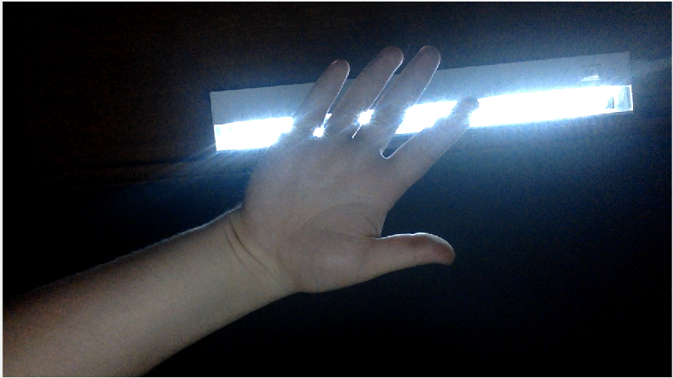
Step 1: Take 2 Pictures

Slide 6
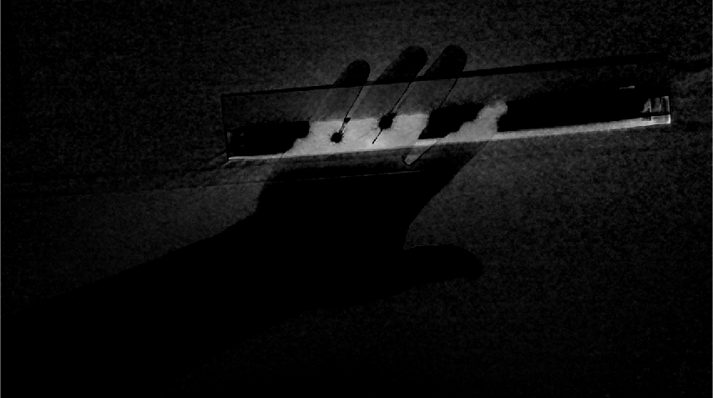
Step 2: Subtract Images

Slide 7

Step 3: Change to Binary

Slide 8

Step 4: Filter Noise

Slide 9
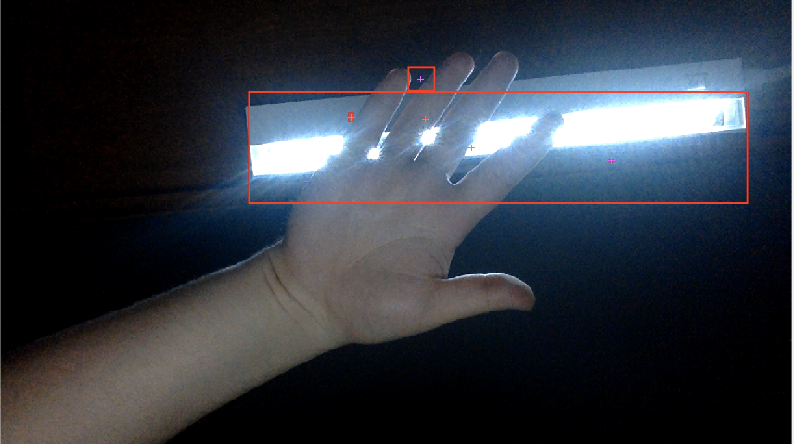
Step 5: Identify Areas of Motion
+
+
+

Slide 10
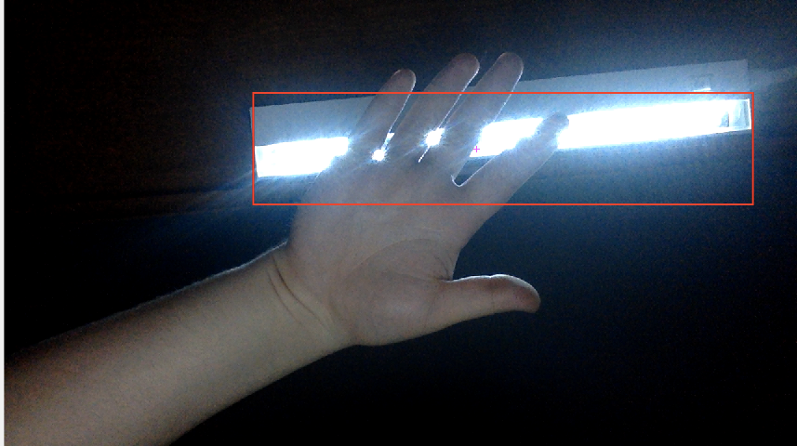
Step 6: Examine Largest Area

Slide 11
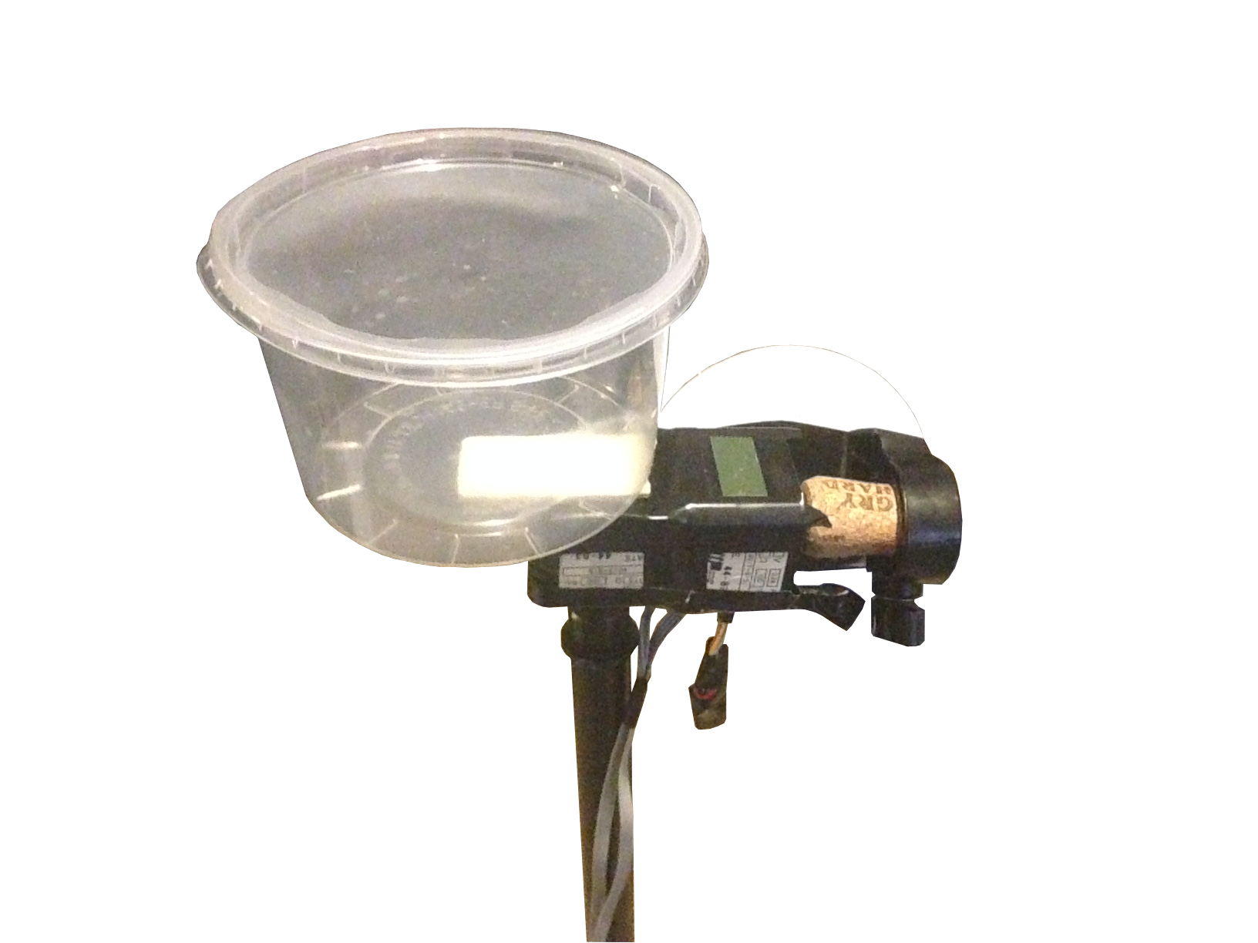
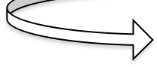
Step 7: Move System

Slide 12
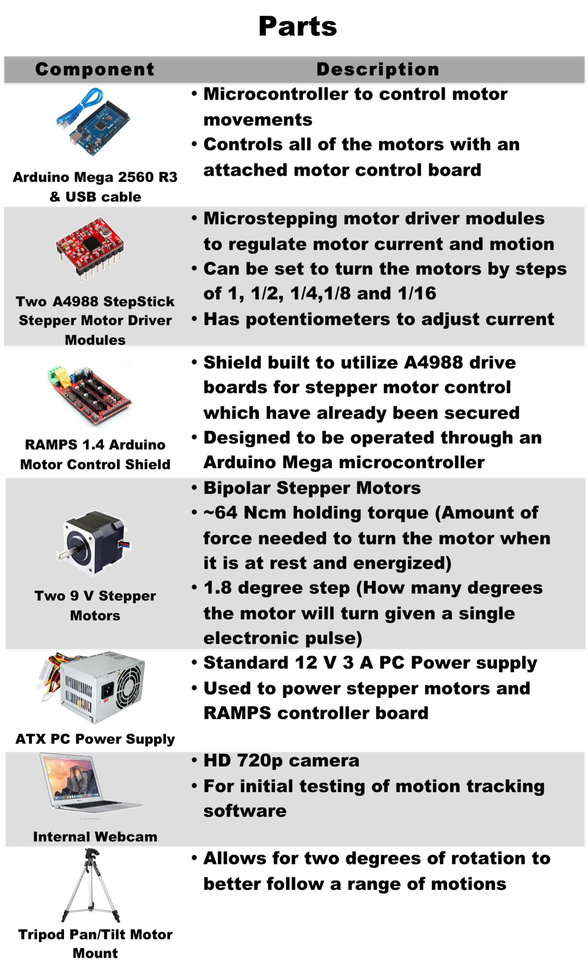
Issues
Parts
Reliant on additional computer
Used MATLAB
Camera had limited sight
Expensive and overkill components
Assembled with hot glue

Slide 13
v2.0 Specifications
Parts
Raspberry Pi Zero
Arduino Uno
Simple stepper motors and control boards
OpenCV programming libraries
Mobile camera
Wall or battery power

Slide 14

v2.0: iSee
28BYJ-48 Stepper Motor
28BYJ-48 Stepper Motor
+
-
D
1N1
1IN2
1N2
1N3
ULN2003 Control Board
ULN2003 Control Board
C
B
5V Power Supply
A
+
-
Arduino Uno R3
D
1N1
1IN2
1N2
1N3
C
B
A
Raspberry Zero
Camera
Circuit Sketch
Design Concept

Slide 15
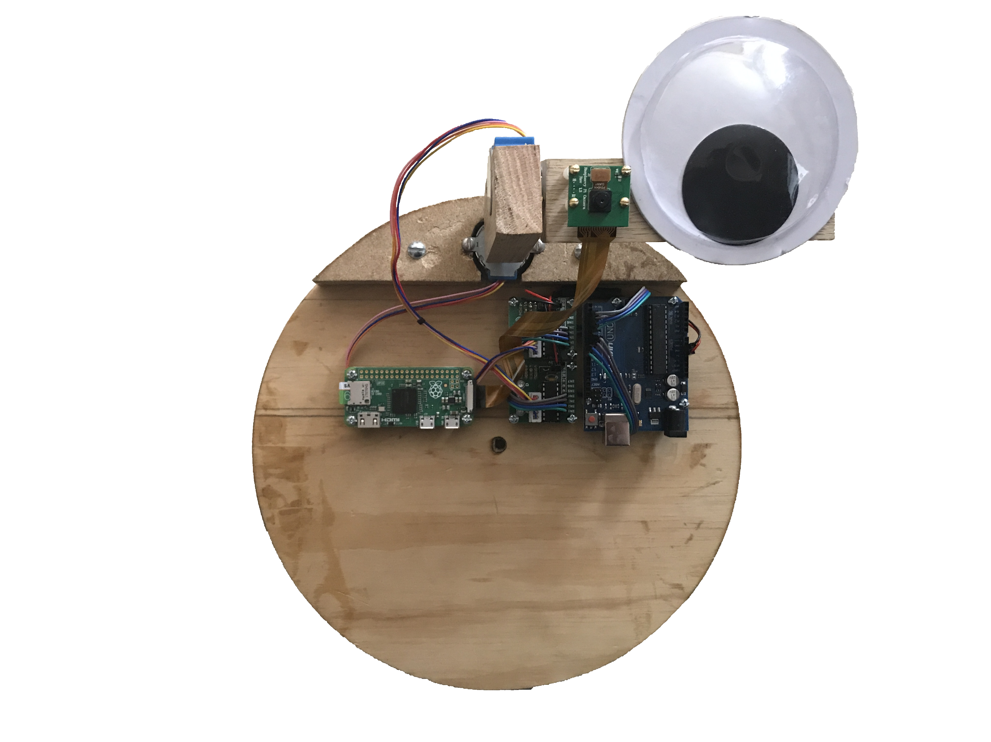
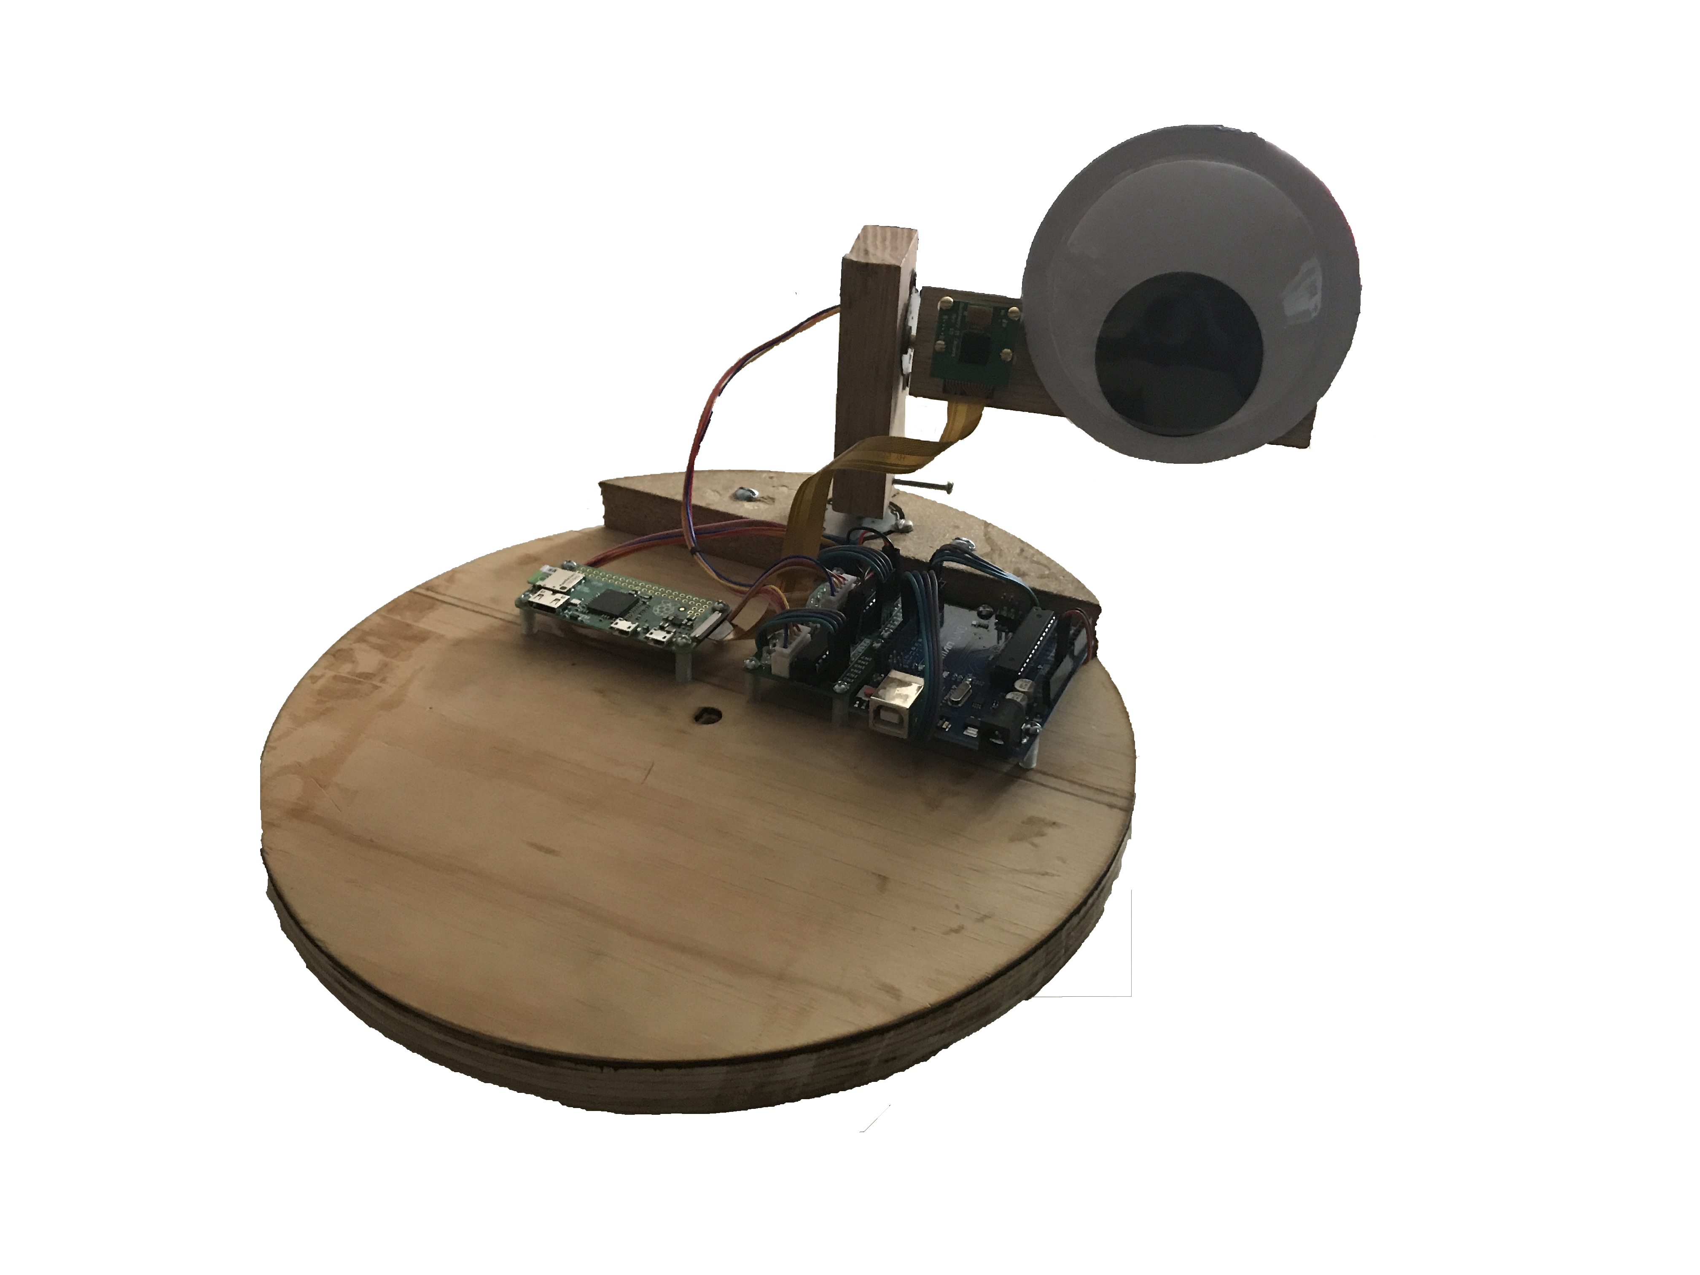
v2.0: iSee

Slide 16
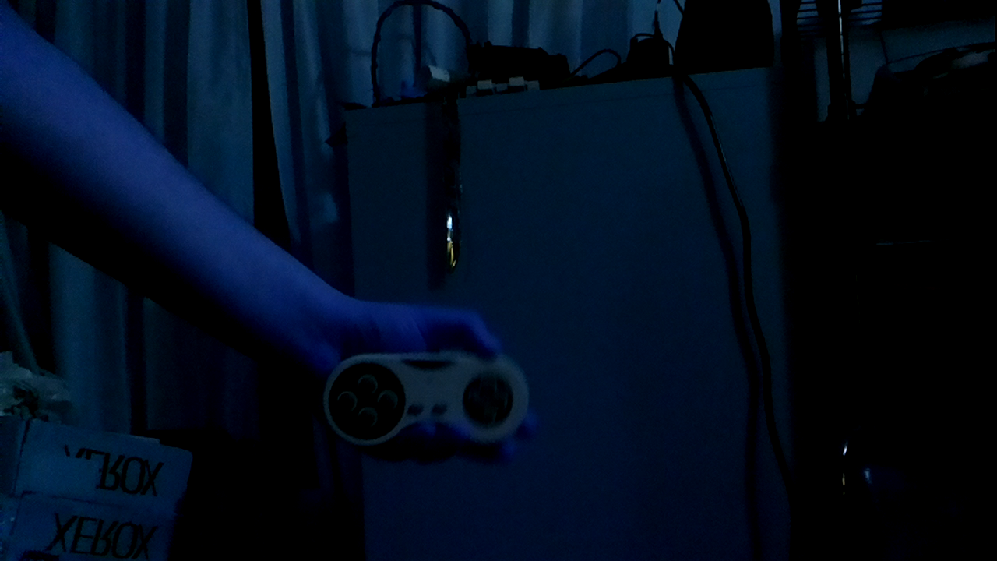
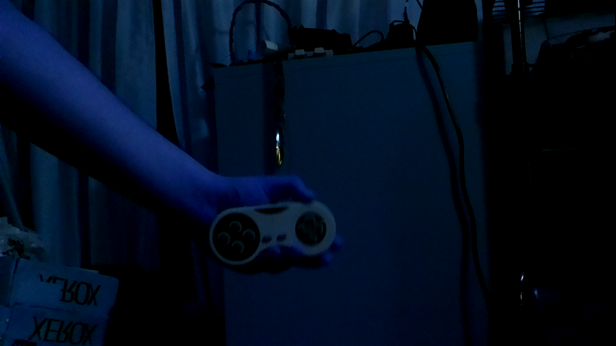
Step 1: Take 2 Pictures

Slide 17
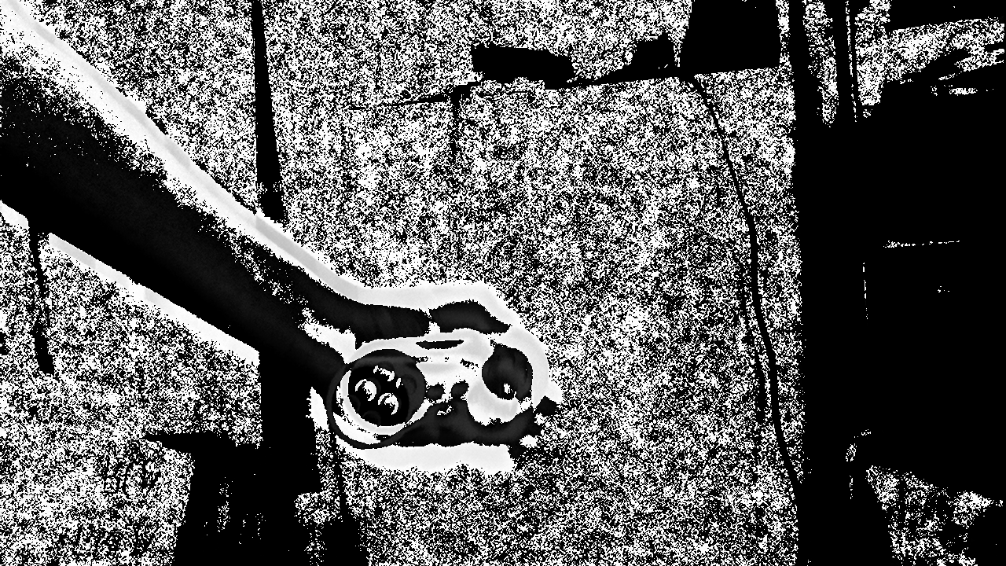
Step 2: Subtract Images

Slide 18

Step 3: Change to Binary

Slide 19

Step 4: Remove Noise

Slide 20
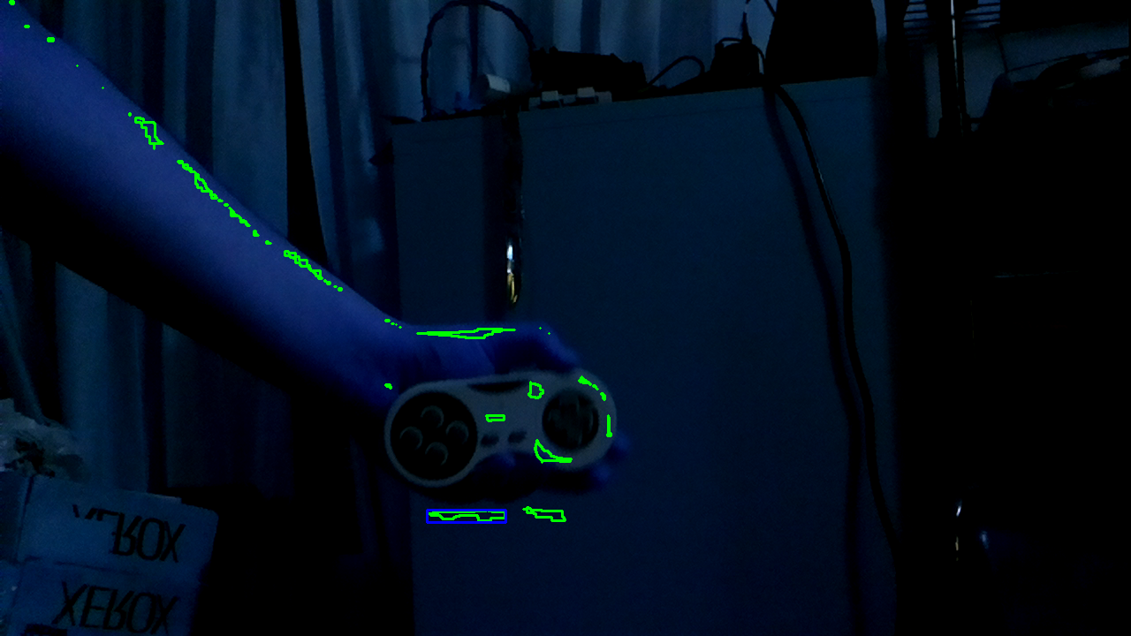
Step 5: Identify Areas of Motion

Slide 21
Step 6: Point at the Motion

Slide 22
Code & Demonstration
https://www.xkcd.com

Slide 23
Code on Github: Yatagarasu50469
https://www.xkcd.com

Slide 24
References
https://picamera.readthedocs.io/en/release-1.10/recipes1.html
https://www.pyimagesearch.com/2015/12/14/installing-opencv-on-your-raspberry-pi-zero/
https://cdn-learn.adafruit.com/downloads/pdf/pi-video-output-using-pygame.pdf
https://www.pyimagesearch.com/2016/04/11/finding-extreme-points-in-contours-with-opencv/

Slide 25
Questions
https://www.xkcd.com

